Slide 1
Leading congregations to lead people to actively follow Jesus Christ.
Rev. Kendall Waller
Director of Administrative Ministries

Slide 2
Devotion: Acts 2:42-47
42 They devoted themselves to the apostles’ teaching and to fellowship, to the breaking of bread and to prayer.
43 Everyone was filled with awe at the many wonders and signs performed by the apostles.
44 All the believers were together and had everything in common.

Slide 3
Devotion: Acts 2:42-47
45 They sold property and possessions to give to anyone who had need.
46 Every day they continued to meet together in the temple courts. They broke bread in their homes and ate together with glad and sincere hearts,
47 praising God and enjoying the favor of all the people. And the Lord added to their number daily those who were being saved

Slide 4
Church as a Business 2022
Combined Local Church Operating Expenses | $ 78,809,051
Apportionments Collected | $ 7,847,926
Other Benevolences | $ 5,366,480
Pensions & Benefits | $ 5,688,947
Advance Specials | $ 716,684
TOTAL | $ 98,429,088

Slide 5
Finance Committee

Slide 6
Who is on Finance?
¶ 258.4 There shall be a committee on finance, elected annually by the charge conference upon recommendation by the committee on nominations and leadership development or from the floor, composed of the chairperson; the pastor(s); a lay member of the annual conference; the chairperson of the church council; the chairperson or representative of the committee on pastor-parish relations; a representative of the trustees to be selected by the trustees; the chairperson of the ministry group on stewardship; the lay leader; the financial secretary; the treasurer; the church business administrator; and other members to be added as the charge conference may determine. It is recommended that the chairperson of the committee on finance shall be a member of the church council. The financial secretary, treasurer, and church business administrator, if paid employees, shall be members without vote.
The positions of treasurer and financial secretary should not be combined and held by one person, and the persons holding these two positions should not be immediate family members.

Slide 7
Four Duties of Finance
Budgeting and Management
Stewardship and Income
Reporting and Communication
Audit and Internal Controls

Slide 8
Budgeting
All financial askings to be included in the annual budget of the local church shall be submitted to the committee on finance. The committee on finance shall compile annually a complete budget for the local church and submit it to the church council for review and adoption. The committee on finance shall be charged with responsibility for developing and implementing plans that will raise sufficient income to meet the budget adopted by the church council. It shall administer the funds received according to instructions from the church council.

Slide 9
What is God calling us to do?
Who will do it?
What will it cost?

Slide 11
Stewardship
Where there is no stewardship ministry area, stewardship shall be the responsibility of a subgroup of the committee on finance or shall be assigned to a task group that shall report to the church council.
The committee shall carry out the church council's directions in guiding the treasurer(s) and financial secretary.

Slide 12
Keys to Effective Stewardship
Have you prayed about it?
Does the Leadership Team tithe?
Does the pastor tithe?
Is the program based on the giver’s need to give or the church’s need to receive?
Can you draw a straight line from each line item of your budget to your mission?
Do you talk about stewardship all year?
Stewardship moments

Slide 13
Reporting and Communication
The importance of transparency
Reports for Church Council

Slide 16
Budgeting
Salaries < 50%
Building 20 to 25%
Apportionments 10%

Slide 17
Year | Membership | AWA | Online AWA | Local Church Operating Expenses | Conference Apportionment | Conference Apportionment Paid | PAL Premiums | Per Attendee Giving for Operation | Percent of Operations for Apportionments | Percent of Operations for PAL
2016 | 115,651 | 43,873 | - | 76,002,278 | 10,102,745 | 9,377,714 | 4,894,252 | $1,732.32 | 13.29% | 6.44%
2017 | 114,663 | 43,045 | 2,369 | 75,097,926 | 9,656,822 | 9,184,572 | 4,444,367 | $1,744.64 | 12.86% | 5.92%
2018 | 112,772 | 42,554 | 2,888 | 75,461,356 | 9,027,667 | 8,427,422 | 4,830,042 | $1,773.31 | 11.96% | 6.40%
2019 | 109,625 | 40,672 | 4,022 | 77,042,256 | 8,845,829 | 7,863,170 | 5,468,897 | $1,894.23 | 11.48% | 7.10%
2020 | 106,177 | 29,229 | 59,264 | 73,289,078 | 8,190,555 | 6,967,190 | 6,059,200 | $2,507.41 | 11.18% | 8.27%
 |  |  |  |  |  |  | 25,696,758

Slide 18
Giving Tracking Sheet
2012 |  |  |  |  |  |  |  |  |  |  |  |  |  | KIDS |  | 1st TIME
 |  | 8:00 | 9:30 | 11:00 | 5:30 |  | MO ATTEND & | TOTAL | AVG PER | MO OFFERING & |  | PRESCHOOL | PDO | SUNDAY SCHOOL |  | VISITOR | TOTAL
SVC | DATE | 1ST | 2ND | 3RD | 4TH | TOTAL | AVG WKLY ATT | OFFERING | ATTENDEE | AVG WKLY OFF | BUILDING | RECEIPTS | RECEIPTS | ATTEND. | OFFER. | FAMILIES | INCOME
1 | 1/1 | 10 | 20 | 125 | 40 | 195 | JANUARY | $5,000.00 | $25.64 | JANUARY |  |  |  |  |  |  | $5,000.00
2 | 1/8 | 12 | 25 | 122 | 45 | 204 | 1,056 | $5,000.00 | $24.51 | $25,000.00 |  |  |  |  |  |  | $5,000.00
3 | 1/15 | 35 | 14 | 127 | 43 | 219 | 211 | $5,000.00 | $22.83 | $5,000.00 |  |  |  |  |  |  | $5,000.00
4 | 1/22 | 33 | 27 | 122 | 47 | 229 |  | $5,000.00 | $21.83 |  |  |  |  |  |  |  | $5,000.00
5 | 1/29 | 27 | 22 | 120 | 40 | 209 |  | $5,000.00 | $23.92 |  |  |  |  |  |  |  | $5,000.00
6 | 2/5 |  |  |  |  | 0 | FEBRUARY |  | #DIV/0! | FEBRUARY |  |  |  |  |  |  | $0.00
7 | 2/12 |  |  |  |  | 0 | 0 |  | #DIV/0! | $0.00 |  |  |  |  |  |  | $0.00
8 | 2/19 |  |  |  |  | 0 | 0 |  | #DIV/0! | $0.00 |  |  |  |  |  |  | $0.00
9 | 2/26 |  |  |  |  | 0 |  |  | #DIV/0! |  |  |  |  |  |  |  | $0.00
10 | 3/4 |  |  |  |  | 0 | MARCH |  | #DIV/0! | MARCH |  |  |  |  |  |  | $0.00
11 | 3/11 |  |  |  |  | 0 | 0 |  | #DIV/0! | $0.00 |  |  |  |  |  |  | $0.00
12 | 3/18 |  |  |  |  | 0 | 0 |  | #DIV/0! | $0.00 |  |  |  |  |  |  | $0.00
13 | 3/25 |  |  |  |  | 0 |  |  | #DIV/0! |  |  |  |  |  |  |  | $0.00
14 | 4/1 |  |  |  |  | 0 | APRIL |  | #DIV/0! | APRIL |  |  |  |  |  |  | $0.00
15 | 4/8 |  |  |  |  | 0 | 0 |  | #DIV/0! | $0.00 |  |  |  |  |  |  | $0.00
16 | 4/15 |  |  |  |  | 0 | 0 |  | #DIV/0! | $0.00 |  |  |  |  |  |  | $0.00
17{2} | 4/22 |  |  |  |  | 0 |  |  | #DIV/0! |  |  |  |  |  |  |  | $0.00
18 | 4/29 |  |  |  |  | 0 | MAY |  | #DIV/0! | MAY |  |  |  |  |  |  | $0.00
19 | 5/6 |  |  |  |  | 0 | 0 |  | #DIV/0! | $0.00 |  |  |  |  |  |  | $0.00
20 | 5/13 |  |  |  |  | 0 | 0 |  | #DIV/0! | $0.00 |  |  |  |  |  |  | $0.00
21 | 5/20 |  |  |  |  | 0 |  |  | #DIV/0! |  |  |  |  |  |  |  | $0.00
22 | 5/27 |  |  |  |  | 0 |  |  | #DIV/0! |  |  |  |  |  |  |  | $0.00
YTD:ATTENDANCE |  | 117 | 108 | 616 | 215 | 1,056 | OFFERING | $25,000.00 |  |  | $0.00 | $0.00 | $0.00 | 0 | $0.00 | 0 | $25,000.00
 |  |  |  |  |  |  |  |  |  |  |  |  |  | *Average |  | VISITOR | TOTAL
# OF WEEKS: |  |  | 5 |  | 5 |  |  |  |  |  | BUILDING | PRESCHOOL | PDO | SS ATT | SS OFF | FAMILIES | INCOME
 |  |  |  |  |  |  |  |  |  |  |  |  |  | SS WEEK | 0
YTD. AVERAGE
ATTENDANCE |  | 23 | 22 | 123 | 43 | 211 | OFFERING | $5,000.00 | $23.67 | -(PER ATTENDEE) |  |  | AVERAGES: | #DIV/0! | #DIV/0! | 0 | $5,000.00
 |  |  |  |  |  |  |  | $5,000.00 | $23.67 | -(PER ATTENDEE INCLUDING BUILDING) |  |  | ATTENDANCE IS ONLY PRE K - 5TH GRADE
 |  |  |  |  |  |  |  |  |  |  |  |  | NO YOUTH OR NURSERY

Slide 19
Giving Tracking Sheet
OPERATIONS BUDGET WEEKLY |  |  |  |  |  |  | BUDGET YTD | $0.00 |  | OVER (UNDER) YTD{1} | $25,025.00
{1} YTD Offering plus YTD Sunday School plus YTD Building minus Budget YTD. |  |  |  |  |  |  |  |  |  | SPECIAL SERVICES ATTENDANCE |  |  | OFFERING
{2} Sunrise attendance added to 8:00 |  |  |  |  |  |  |  |  |  | Ash Wednesday
 |  |  |  |  |  |  |  |  |  | Holy Week Service
 |  |  |  |  |  |  |  |  |  | Easter Sunrise
 |  |  |  |  |  |  |  |  |  | Christmas Eve 12/23
 |  |  |  |  |  |  |  |  |  | Christmas Eve 2:30
 |  |  |  |  |  |  |  |  |  | Christmas Eve 4:00
 |  |  |  |  |  |  |  |  |  | Christmas Eve 5:30
 |  |  |  |  |  |  |  |  |  | Christmas Eve 7:00
 |  |  |  |  |  |  |  |  |  | Christmas Eve 8:30
 |  |  |  |  |  |  |  |  |  | Christmas Eve total | 0

Slide 20
Reporting and Communication
Reporting to the church
Missional Budget
The committee shall carry out the church council's directions in guiding the treasurer(s) and financial secretary

Slide 21
Reporting and Communication
Tax Records
Donors who make a contribution of $250 or more must have a “contemporaneous written acknowledgment from the donee organization.” This written document should include the church’s name (perhaps on letterhead) and provide the following data:
The name of the donor.
The date and amount of each contribution of $250 or more during the year.
A statement that no goods or services were provided to the donor in exchange for the contribution. (an exception, of course, is the “intangible religious benefits” provided by the church’s ministry.)
A description and good faith estimate of the value of any noncash property contributed.

Slide 22
Record Retention
http://gcah.org/resources/managing-records-of-the-annual-conference-and-local-church This booklet offers answers to many common questions about which records to keep and for how long.

Slide 23
Record Retention
Some of the suggested retention periods are for legal reasons, while others are based on practical considerations. You may want to keep some records longer than the table suggests.
Some of the reasons to keep files and records include legal requirements, potential relevance in future litigation, and the needs of the organization, as well as historic importance.
Of particular importance is the retention of insurance policies and related documents. From time to time, lawsuits are brought which reach back many years. Therefore, it is important to determine the policy in effect at the time that a claim arose.

Slide 24
Audits and Internal Controls
¶ 258.4 cont’d
c) The committee on finance shall establish written financial policies to document the internal controls of the local church. The written financial policies should be reviewed for adequacy and effectiveness annually by the committee on finance and submitted as a report to the charge conference annually.

Slide 25
Internal Controls Minimums
Internal policies, at a minimum, might include:
• who collects, counts, records, and deposits all monies
• who is part of the counting team (not less than two non-family members should count and verify offerings (258.4a)
• distribution on contribution records
• authorization process for purchases
• check signing policy
• bank reconciliation
• reimbursement policy with documentation
• petty cash disbursement/purposes/accounting

Slide 26
Internal Controls Resources
We suggest the following resources may be helpful in developing Internal Controls policies:
“Guidelines for Leading Your Congregation 2017-2020 – Finance” may be ordered from Cokesbury (ISBN 9781501829666 for $3.99).
“2017-2020 United Methodist Church Financial Records Handbook”, publication date August 2018, order from Cokesbury (ISBN 9781501835711.

Slide 27
Counting and Separating Duties
¶ 258.4 cont’d
a) The committee shall designate at least two persons not of the immediate family residing in the same household to count the offering. They shall work under the supervision of the financial secretary. A record of all funds received shall be given to the financial secretary and treasurer. Funds received shall be deposited promptly in accordance with the procedures established by the committee on finance. The financial secretary shall keep records of the contributions and payments.

Slide 28
Audits
¶ 258.4 cont’d
d) The committee shall make provision for an annual audit of the financial statements of the local church and all its organizations and accounts…
A local church audit is defined as an independent evaluation of the financial reports and records and the internal controls of the local church by a qualified person or persons…

Slide 29
Audits
The audit may include:
1) a review of the cash and investment reconciliations
2) interviews with the treasurer, financial secretary, pastor(s), finance committee chair, business manager, those who count offerings, church secretary, etc., with inquiries regarding compliance with existing written financial policies and procedures
3) a review of journal entries and authorized check signers for each checking and investment account
4) other procedures requested by the committee on finance.

Slide 30
The Local Church Audit Guide
www.gcfa.org/media

Slide 31
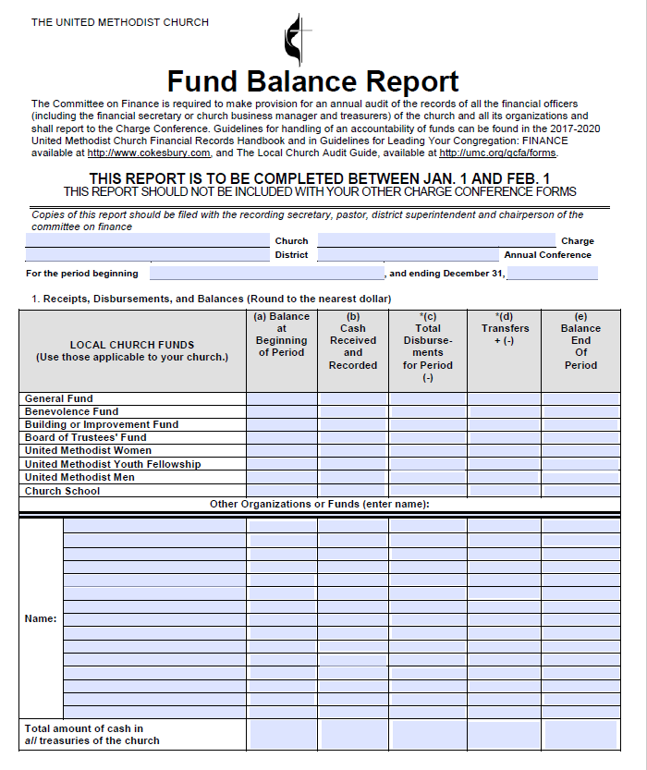
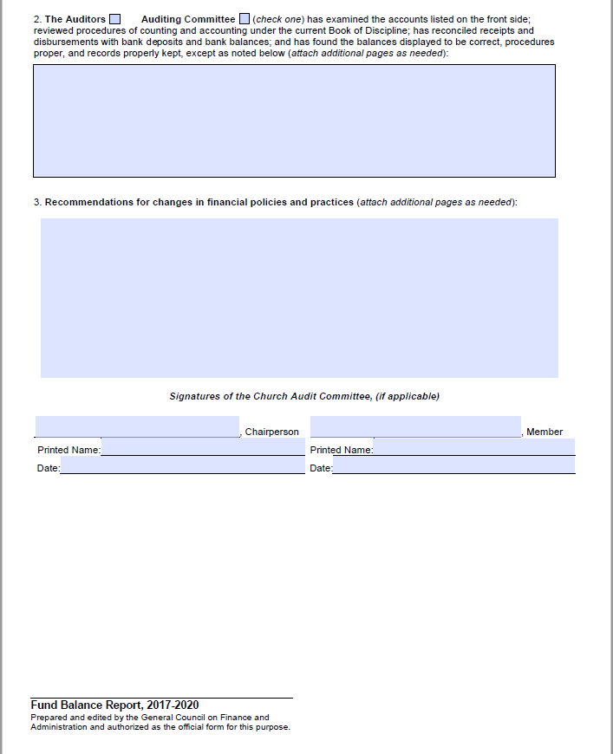
Audit Form
The committee shall make a full and complete report to the annual charge conference.

Slide 32
Additional Considerations
¶ 258.4 cont’d
Contributions designated for specific causes and objects shall be promptly forwarded according to the intent of the donor and shall not be used for any other purpose. 11
After the budget of the local church has been approved, additional appropriations or changes in the budget must be approved by the church council.
The committee shall prepare annually a report to the church council of all designated funds that separate from the current expense budget.
11. See Judicial Council Decision 976.

Slide 33
UNITED METHODIST CLERGY
Special

Slide 34
ANSWERS TO 3 KEY QUESTIONS

Slide 35
CLERGY PAY WHAT?

Slide 36
INCOME TAX
Governed by:
Internal Revenue Code
Internal Revenue Regulations
Revenue Rulings
U.S. Court Decision
All Subject to Change!

Slide 37
SOCIAL SECURITY AND MEDICARE TAXES

Slide 38
PAYROLL TAX
Governed by either:
Self Employment Contributions Act (SECA)
Federal Insurance Contributions Act ( FICA)
These taxes fund Social Security and Medicare.

Slide 39
PAYROLL TAX
The tax rate for Social Security and Medicare is 15.3% of Wages/Income.
In FICA
½ is paid by the employer (7.65%)
½ is withheld from employee paychecks (7.65%)
Key Point: The Employer Pays FICA.

Slide 40
BUT
A self-employed individual pays under SECA and is responsible for paying the entire share.
WHY?
They employ themselves.

Slide 41
AS CLERGY WE PAY WHICH ONE?
Most people with an employer pay FICA …
But clergy are special so …
CLERGY PAY SECA!

Slide 42
CLERGY WORK FOR WHO?

Slide 43
Conference, bishop, local church or conference board of pensions?

Slide 44
THE LOCAL CHURCH
At least as far as income tax is concerned

Slide 45
EMPLOYMENT STATUS?
Seriously? What does that mean?

Slide 46
REMEMBER
Clergy are treated as employees of the salary paying unit.

Slide 47
That was for
purposes of income tax.

Slide 48
BUT, REMEMBER, CLERGY ARE SPECIAL …
CLERGY ARE ALSO RESPONSIBLE FOR SECA.

Slide 49
Congress made clergy self-employed for purposes of SECA.
Simple, right?

Slide 50
SECA
Most people who pay SECA have a particular employment status
They aren’t “employees” at all
They are “independent contractors”
That means they aren’t “employees” of who/whatever is paying them

Slide 51
SO WHAT?
When someone is an “independent contractor,” the “employer” will issue a tax form called a 1099 which will list the amounts paid during the course of the preceding year. They do NOT get a W-2.

Slide 52
CLERGY GET A W-2
Despite paying SECA, clergy are “employees” for income tax purposes

Slide 53
CLERGY THUS …
Receive benefits through the administration of the conference and are supervised by their bishop but are employed by the local church for purposes of income tax.
But clergy are self-employed for purposes of Social Security and Medicare, meaning they pay SECA, which is paid by them individually by April 15 and filed as a schedule SE with the rest of their tax returns.
BUT, as employees of local churches they are issued a W-2 by January 31 of each year, reflecting the wages paid by the local church with notes for tax-deferred pension and housing (we’ll get there later).

Slide 54
CHURCHES SHOULD NOT …
Give clergy a 1099 reflecting their salary support; or
Withhold and pay FICA from and on behalf of clergy
Elder
Deacon
Licensed Local Pastor

Slide 55
CHURCHES SHOULD …
Give clergy a W-2 reflecting the cash support paid during the year
Show - 0 - in the boxes for Social Security and Medicare Wages

Slide 56
INCOME TAX BASICS
In case you’ve never had it explained
This is all subject to change by act of Congress.

Slide 57
HOUSING

Slide 58
HOUSING
At least as of today, compensation (cash or in-kind) paid to clergy in the form of “housing” is exempt from INCOME TAX. (That same compensation MUST be reported and IS subject to SECA.)
This is due to an old section of the Internal Revenue Code (26 U.S.C. sec. 107), and it HAS been and will probably continue to be challenged on grounds of the Establishment Clause of the 1st Amendment of the U.S. Constitution
In fact, in October, the U.S. Circuit Court for the Western District of Wisconsin found 26 U.S.C. section 107(2) violated the Establishment Clause.
For now, but only for now, housing treatment remains as it has always been.

Slide 59
WHAT IS HOUSING?
Parsonages
Housing allowances
Amounts paid for utilities
Amounts paid for “furnishings”

Slide 60
THIS IS ACTUALLY A BENEFIT
Something to remember:
(Even if SECA hurts)

Slide 61
WHAT’S THE RULE?
Clergy can exempt from INCOME TAX (not SECA) any compensation (in-kind or cash) paid for housing including
Rent
Mortgage payments
Utilities
Furnishings or other expenses related to housing

Slide 62
ACCOUNTABLE REIMBURSEMENT
Church must adopt an accountable reimbursement policy (charge conference form in Missouri)
Clergy will then account for expenses to the local church, NOT the IRS and reimbursements are NOT considered income (not taxed) AND it avoids SECA!!!
BUSINESS RELATED (No personal use)
Key rule: ADEQUATE ACCOUNTING
Itemized receipts
Mileage logs (beginning reading/end reading)

Slide 63
MILEAGE
Rate of reimbursement for business-travel: $.655/mile
No commuting miles (home office exception)
Alternative: Actual costs (reimbursing clergy for gas)

Slide 64
A Word about Tax Reform

Slide 65
Detrimental Changes for UMC Clergy
Moving expenses no longer deductible
Reimbursed moving expenses now taxable
Charitable contributions will largely have no impact on taxes
Mortgage Interest also less relevant AND risk of loss for housing allowance

Slide 66
https://www.moumethodist.org/resourcedetail/clergy-tax-webinar-12412487
Missouri Conference
Clergy Tax Webinar
Nate Berneking

Slide 67
Tax issues
Effects of recent tax reforms
Housing Exclusion
Moving Expense
Affordable Care Act?

Slide 68
Tax Resources
www.gcfa.org
Departments & Services
Legal services
Tax Packet
www.store.churchlawandtax.com
Church & Clergy Tax Guide

Slide 69
Clergy Compensation Form
The Pastoral Support Form is a very important document.
It is an official agreement between the church and the pastor.
Information reported on this form is used for several purposes:
Setting pastoral compensation for the local church / charge.
Reporting compensation to the General Board of Pension
Reporting compensation to the Internal Revenue Service
Reporting compensation to the Appointive Cabinet

Slide 70
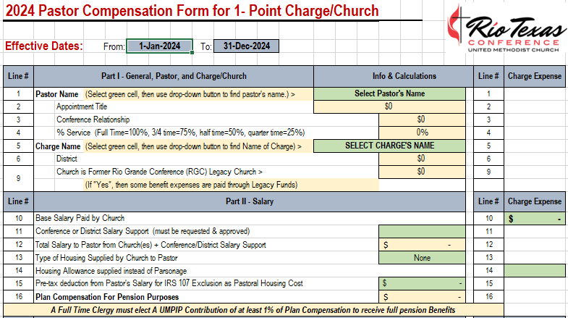

Slide 71
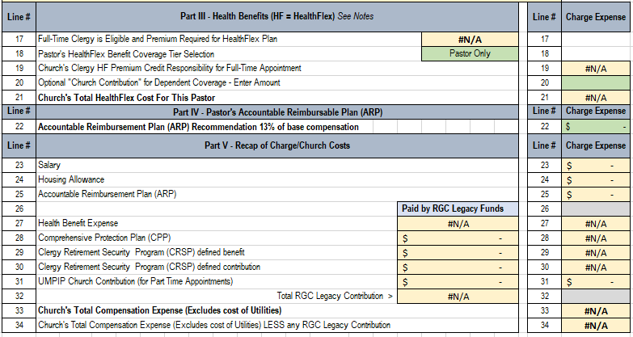

Slide 72
Figuring Apportionments
Qualified Expenses
Find Conference Wide Total Expense
Determine the Decimal
Multiply by the Budget

Slide 73
So, Why did ours change?
Local Church Spending relating to the Conference Total
The Conference Budget
Closed Churches

Slide 74
Leading congregations to lead people to actively follow Jesus Christ.
Rev. Kendall Waller
Director of Administrative Ministries

